Slide 1
Team WhatTheHack?!
Ben, Chris, Julia, Shiv, Tony

Slide 2
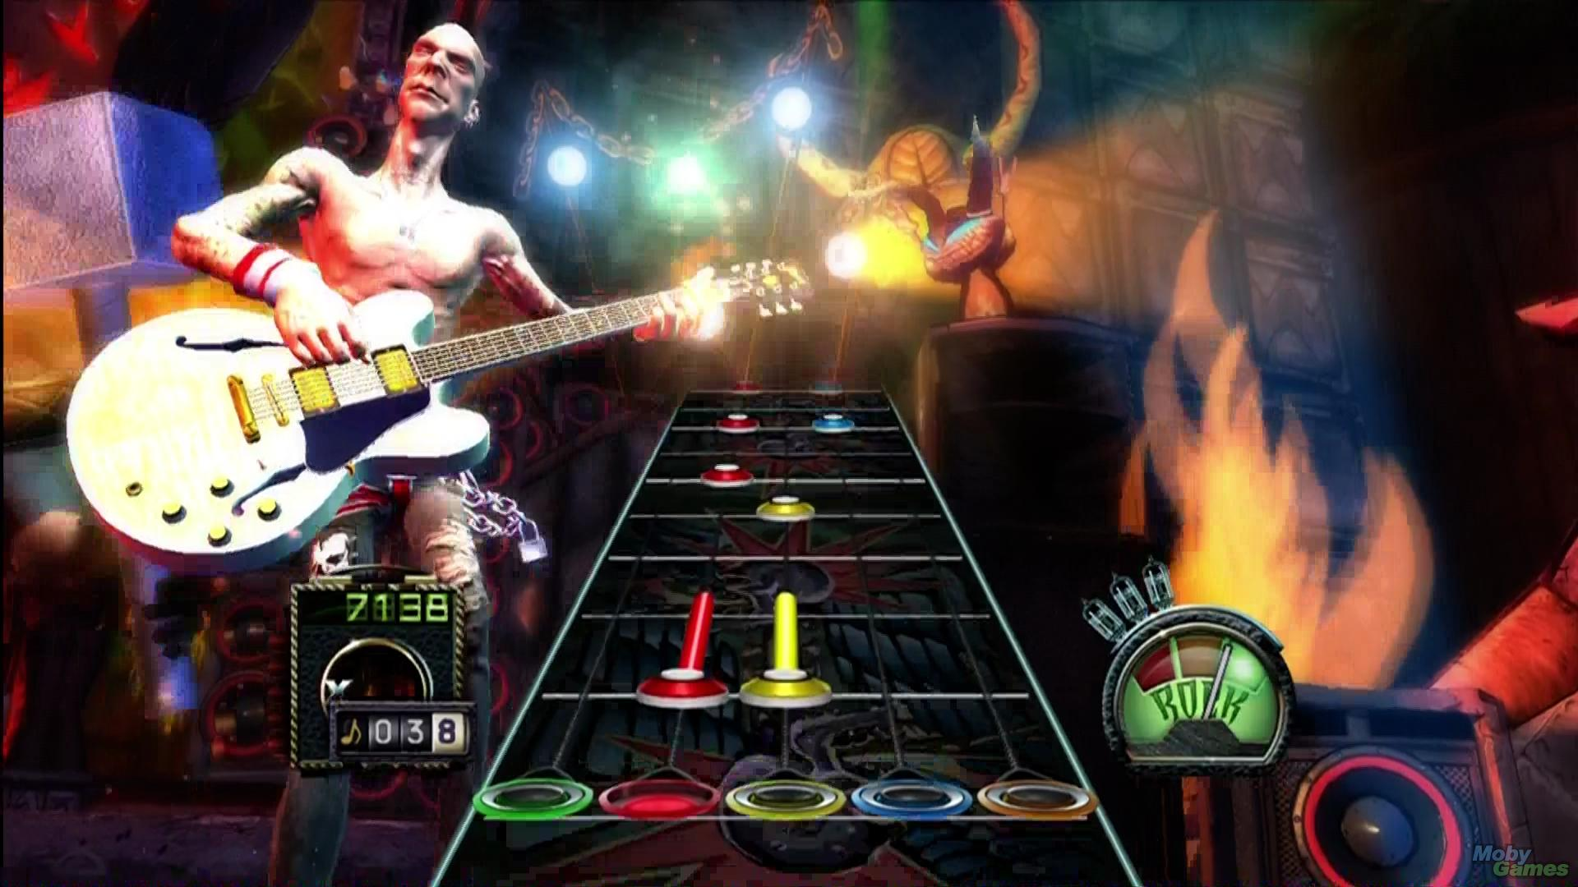
NO AI!

Slide 3

Challenge #3: Emotional AI
Guitar Hero + Deep Learning = Fun!

Slide 4
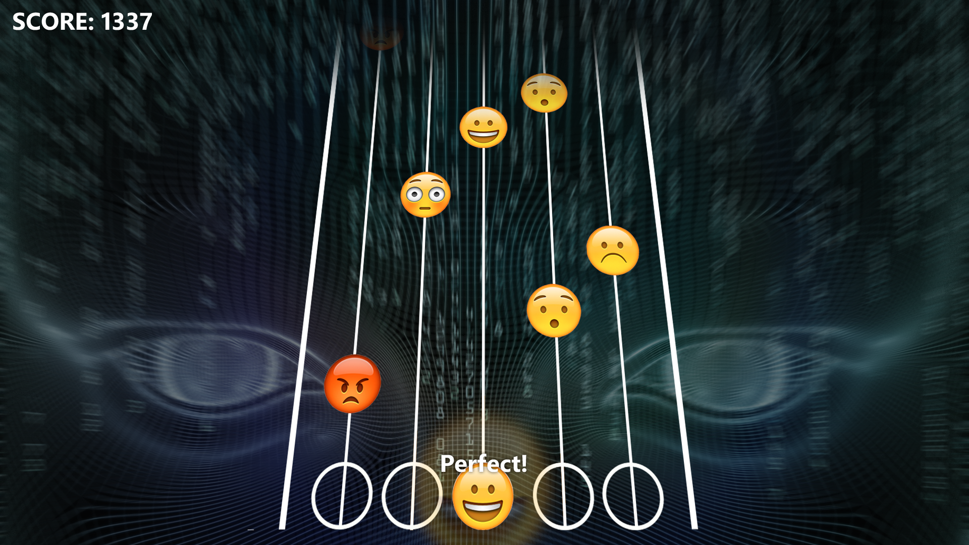

Slide 5


Features
Deep Learning
TensorFlow
Facial Emotion Recognition
Data: As much as we can up with...
Emotional Hero App
iOS
Online leaderboards
Special effects … probably … in case there is time left ... :-)

Slide 6
Thx! Have fun! :-)

